Slide 1

Group 2
Retinopathy Diabetic Detector
Group Members:-
Sameer Herkal
Aaditya Mhadye
Suresh Solanki
Ashutosh Jha

Slide 2

Problem Statement
The variable to be predicted has two values (positive or negative on diabetic retinopathy). Thus, this is a binary classification project. The goal here is to predict whether a patient will suffer from diabetic retinopathy or not, conditioned on blood test features.

Slide 3
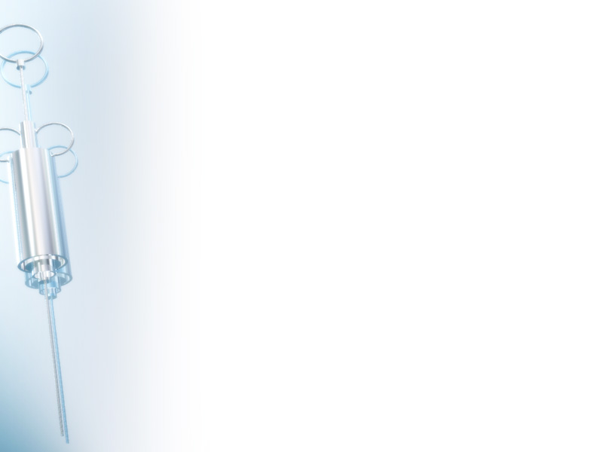
About Dataset
Independent Variable / Features :- age, systolic_bp, diastolic_bp, cholesterol
Dependent Variable / Target Variable :- prognosis
Shape of dataset :- (6000*5)
There is no duplicate values.
There is no missing values.
S.No | Columns | Count | Dtype
1 | Age | 6000 | Float64
2 | systolic_bp | 6000 | Float64
3 | diastolic_bp | 6000 | Float64
4 | cholesterol | 6000 | Float64
5 | prognosis | 6000 | int32

Slide 4

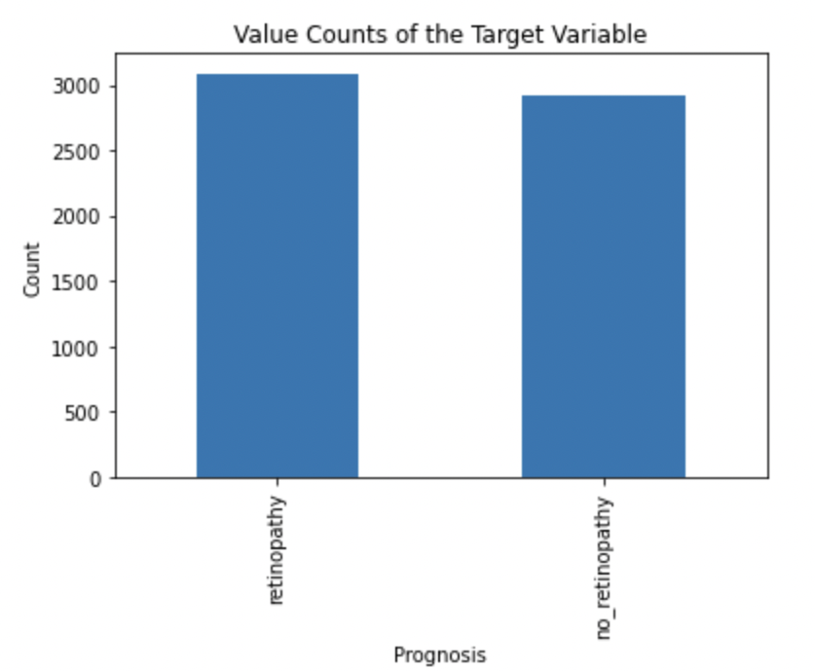
Value Counts of Target Variable (Prognosis)
Value Counts: -
Retinopathy – 3087
No Retinopathy – 2913
Value Counts in % : -
Retinopathy – 51.45%
No Retinopathy – 48.55%
Encoded the Target Variable: -
Retinopathy → 1
No Retinopathy → 0

Slide 5

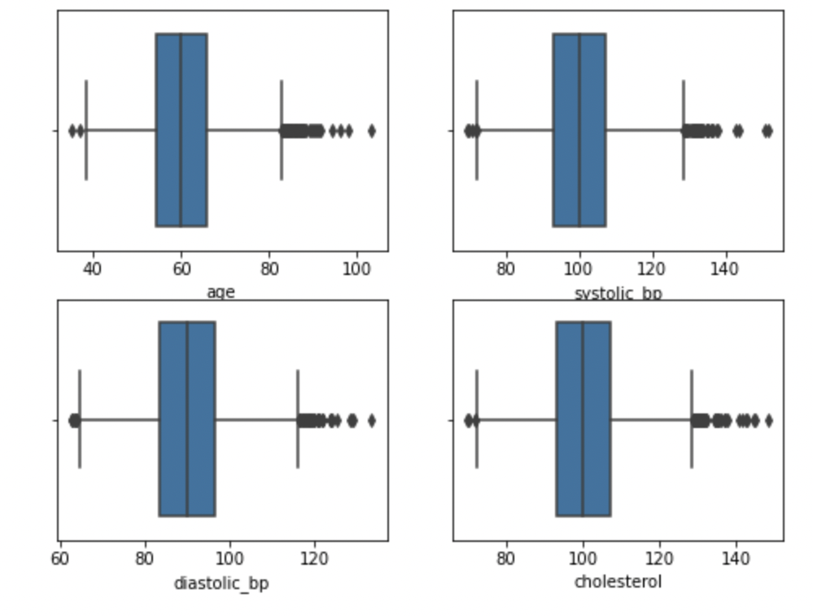
Visualizing the Boxplot
We used Z-score to check the outliers.
If Z score is more than 3 that means that data point is an outlier.
We dropped all those datapoints.
The shape of data after dropping off all the outliers is (5907*6).

Slide 6

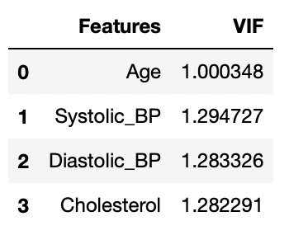
Checking Multicollinearity
From the table we can conclude that, there is no much multicollinearity amongst all the variables.
Therefore, we can consider all the variables.

Slide 7

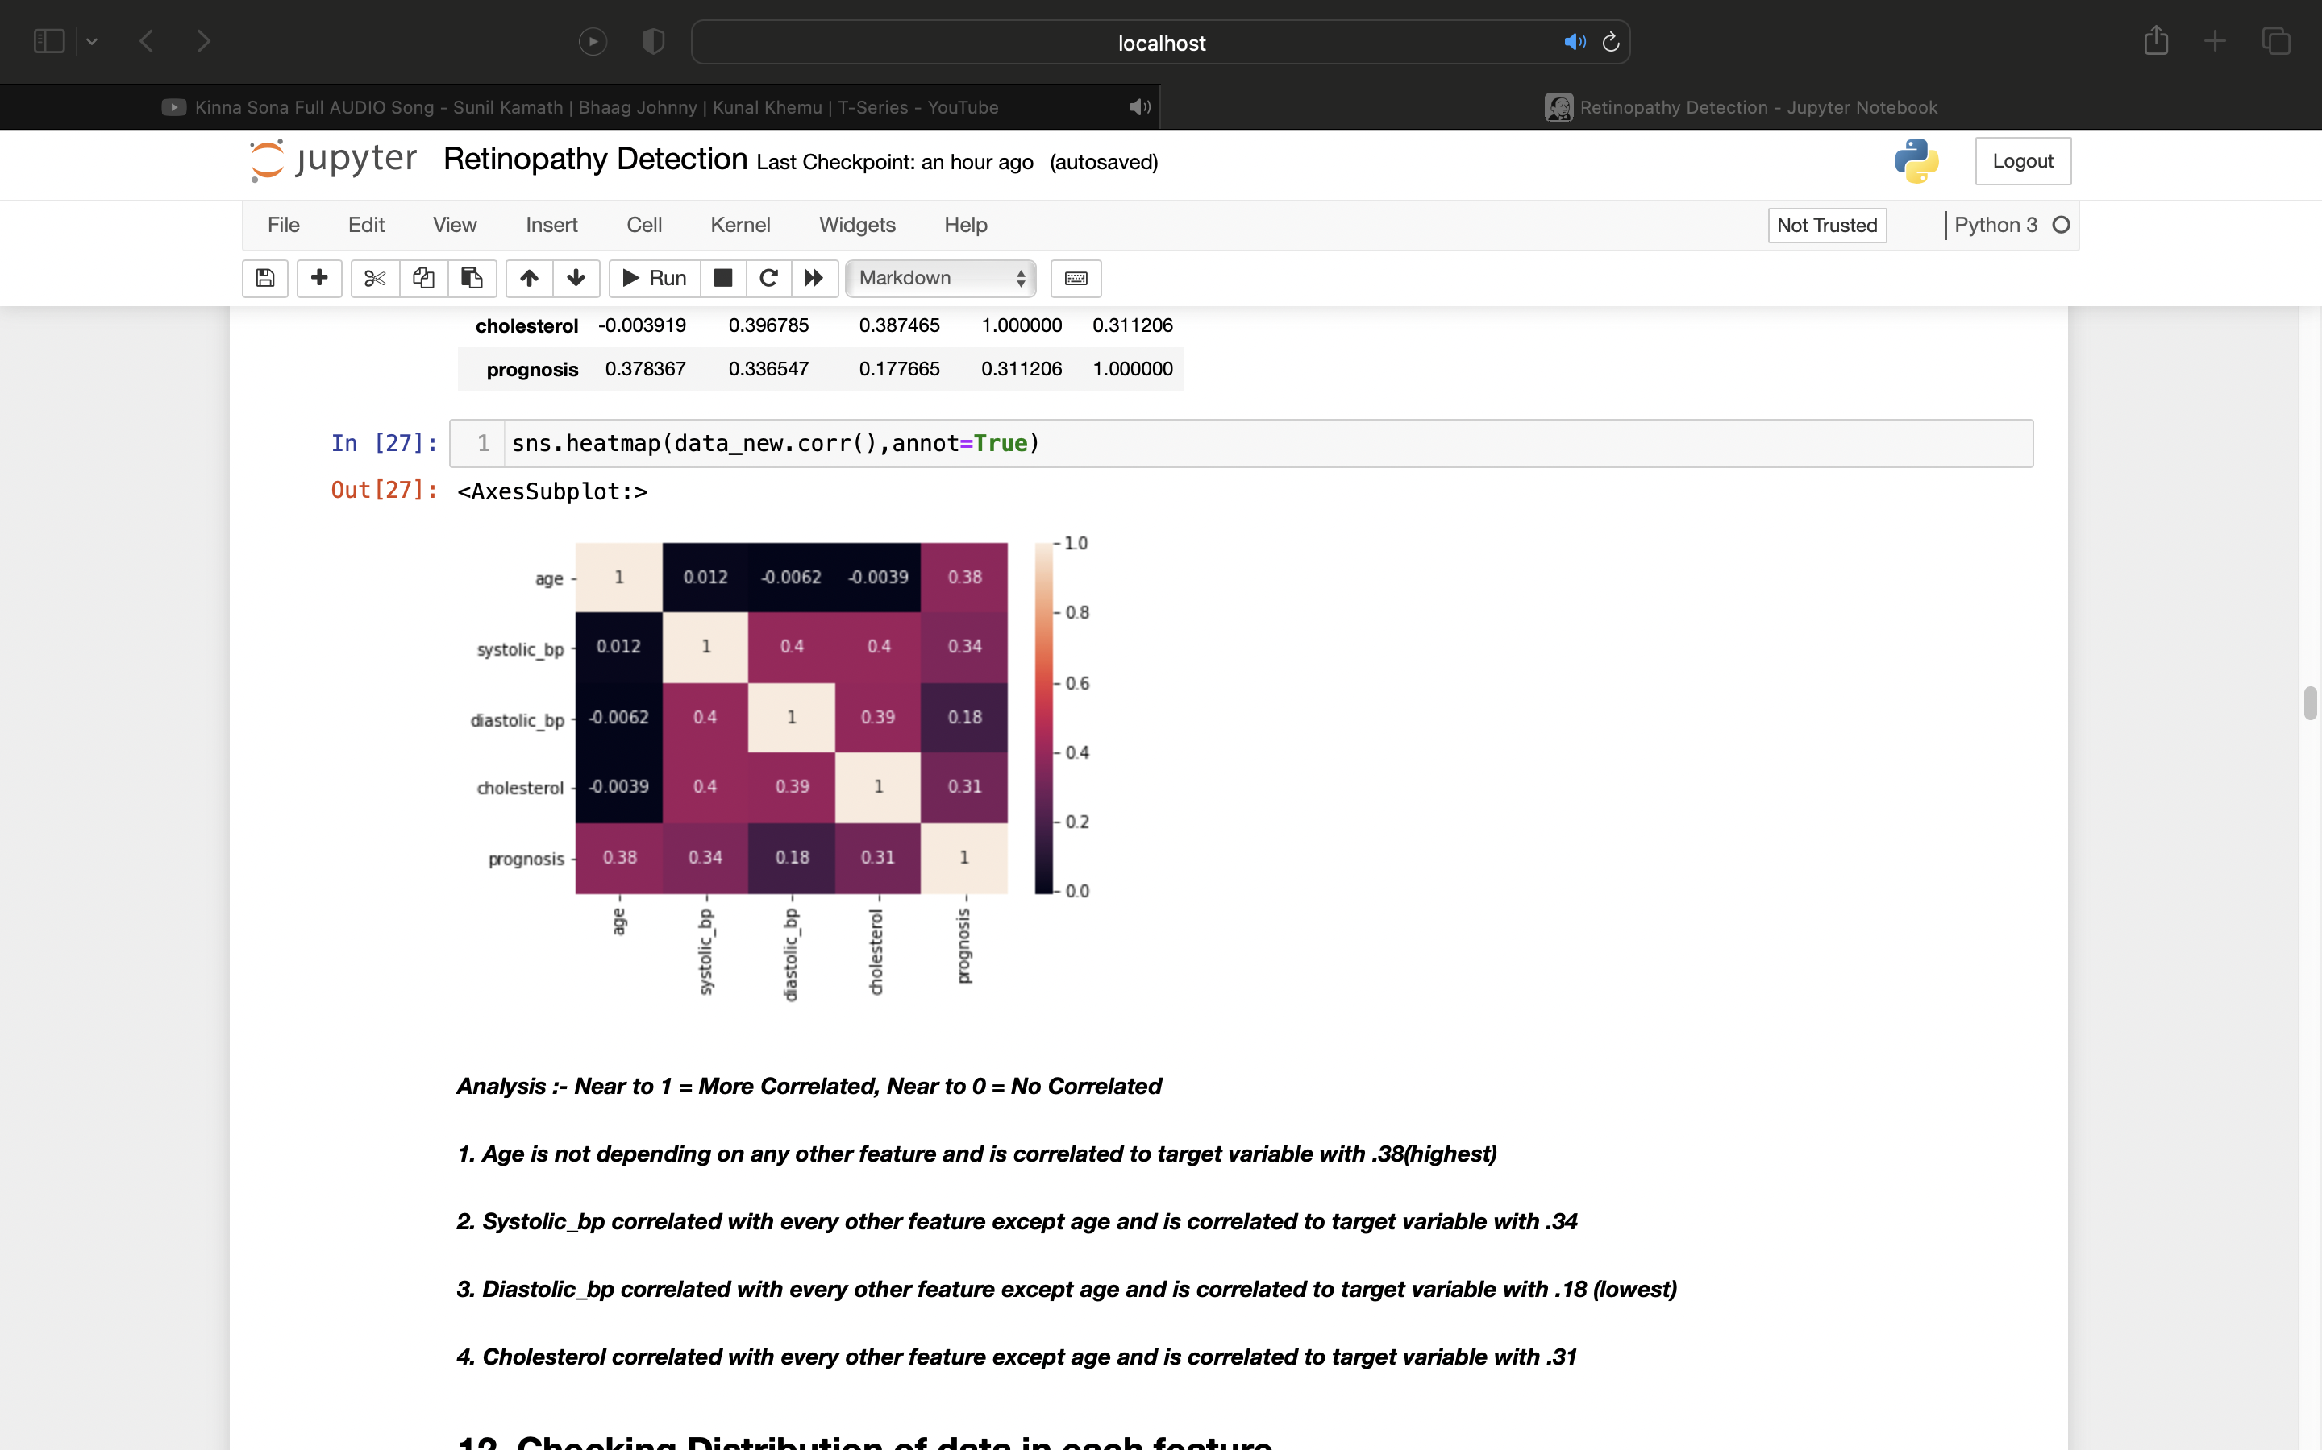
Correlation
Analysis :-
Near to 1 = More Correlated,
Near to 0 = No Correlated
1. Age is not depending on any other feature and is correlated to target variable with .38(highest)
2. Systolic_bp correlated with every other feature except age and is correlated to target variable with .34
3. Diastolic_bp correlated with every other feature except age and is correlated to target variable with .18 (lowest)
4. Cholesterol correlated with every other feature except age and is correlated to target variable with .31

Slide 8

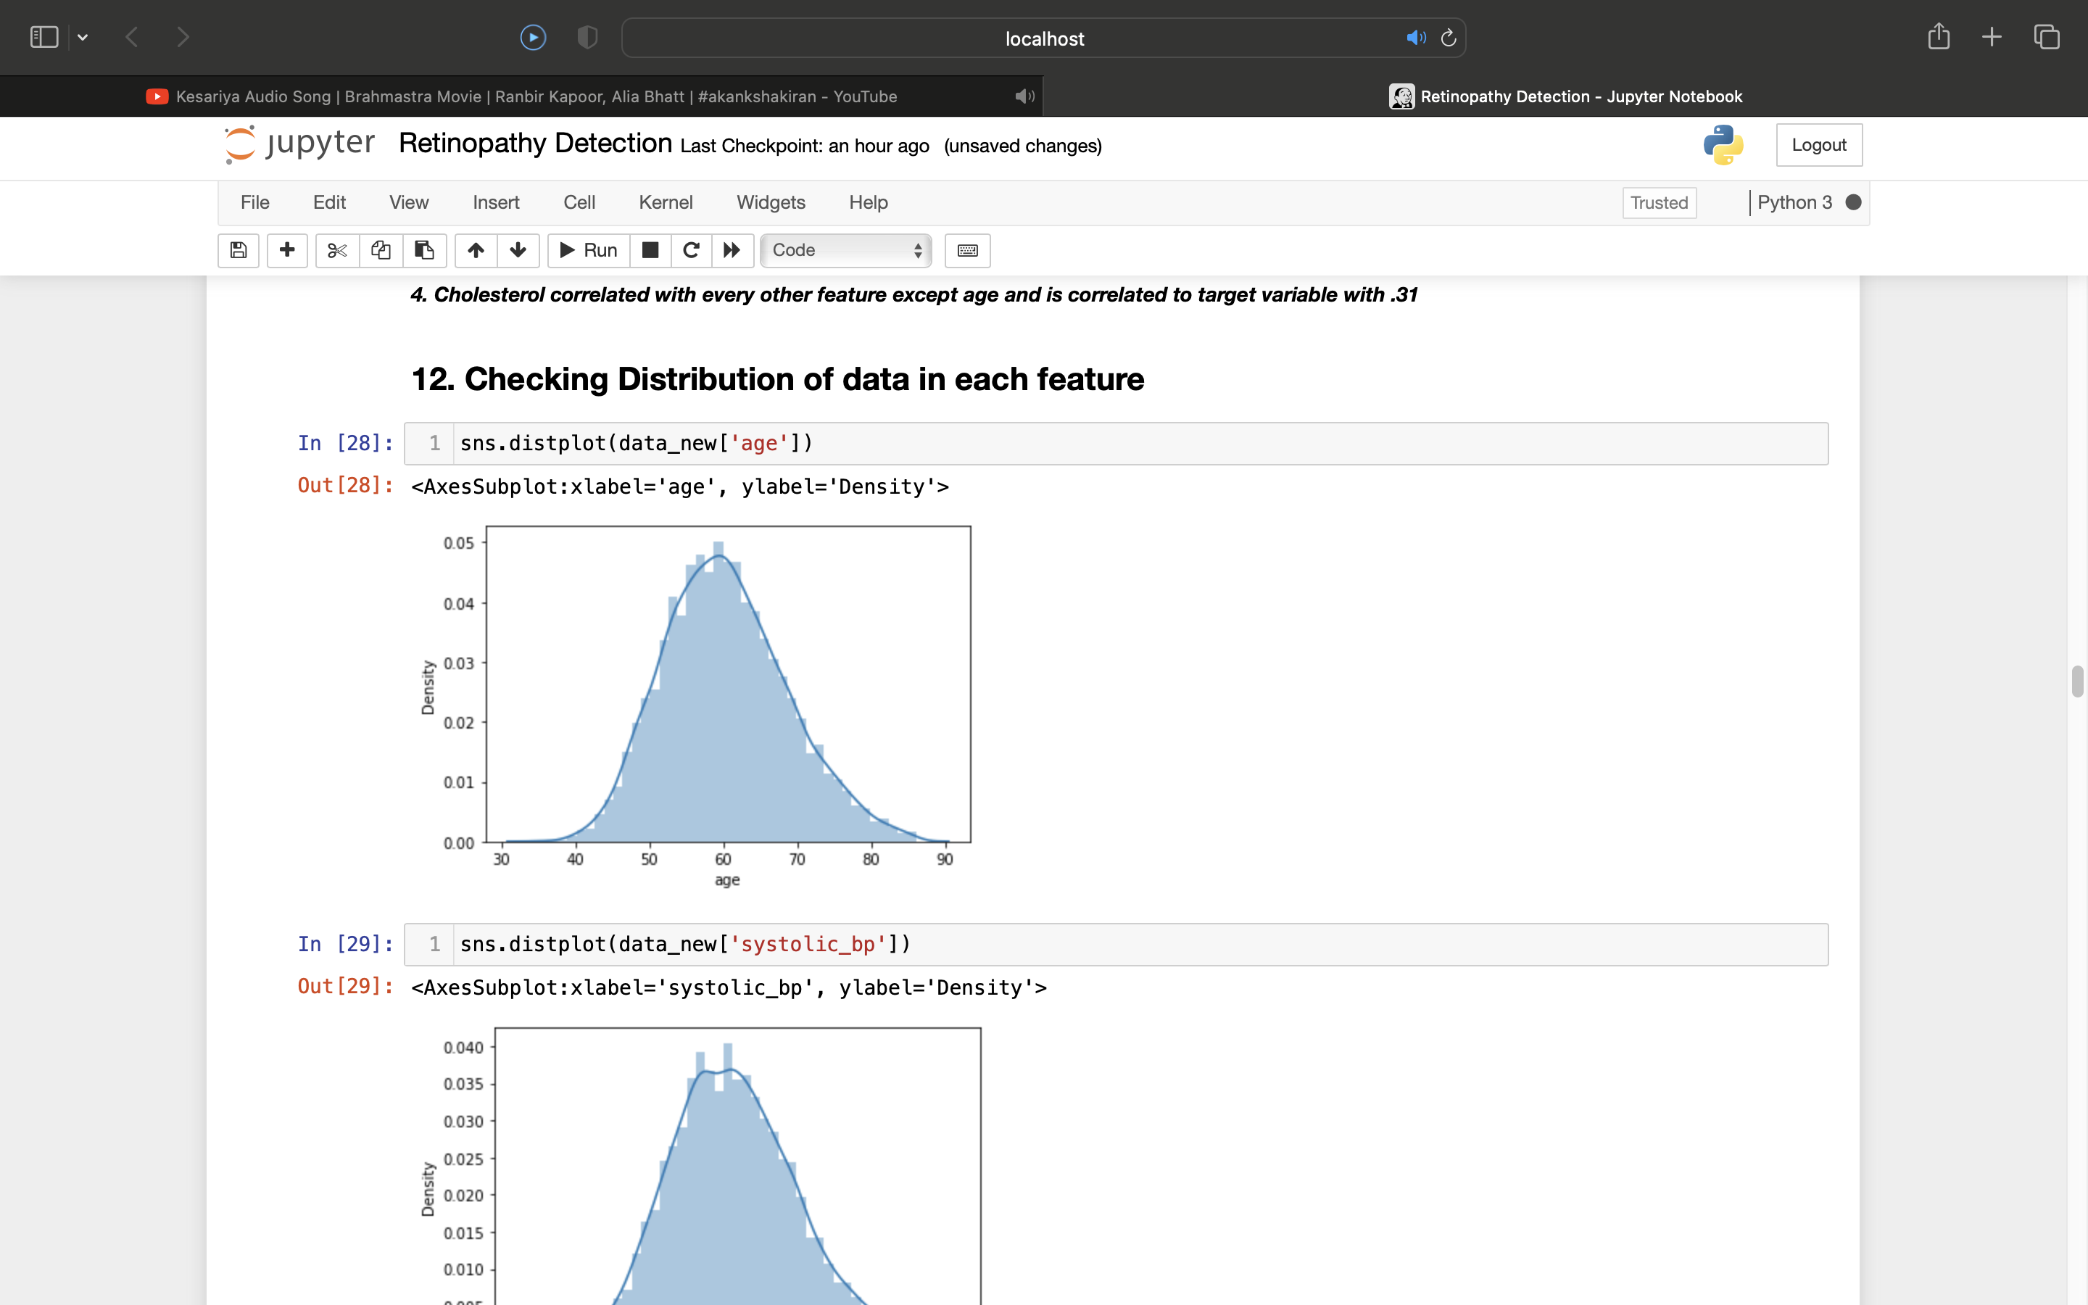
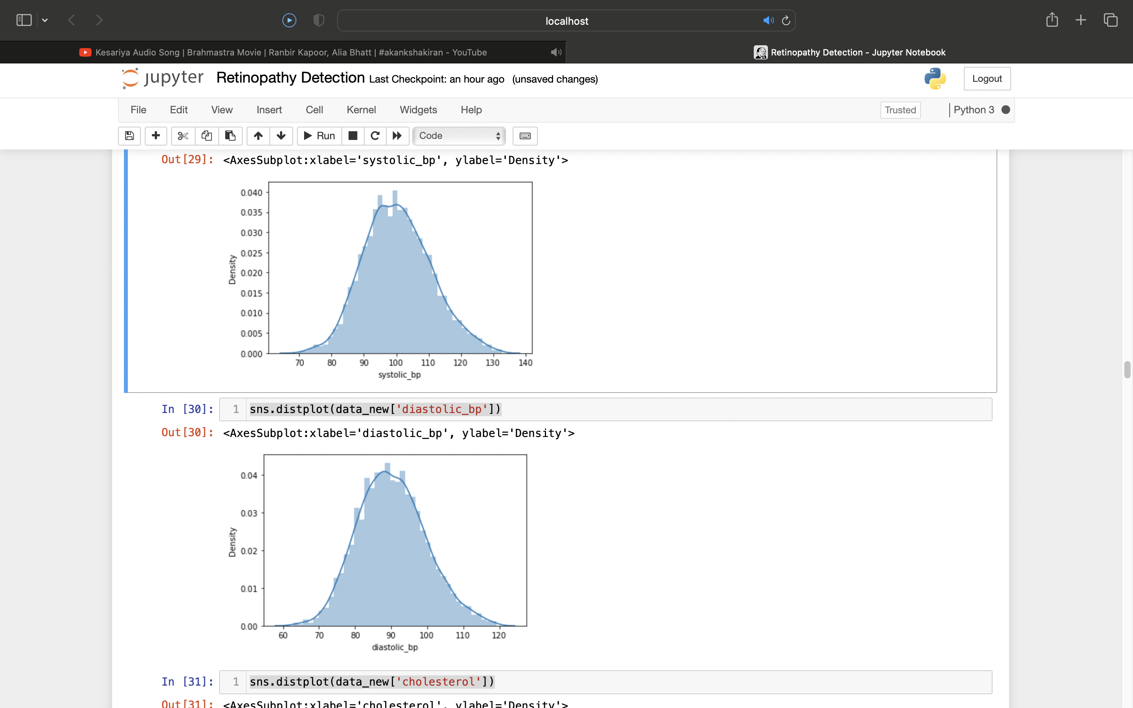
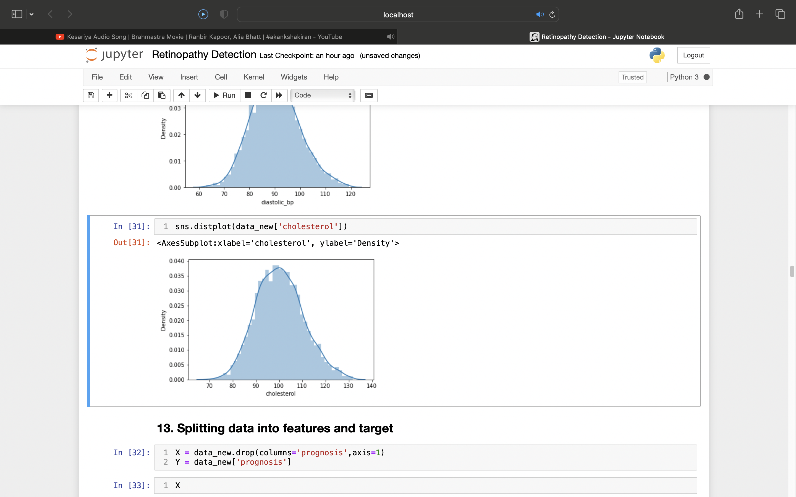
Distribution Graph of Features
All the data in each feature are normally distributed.

Slide 9

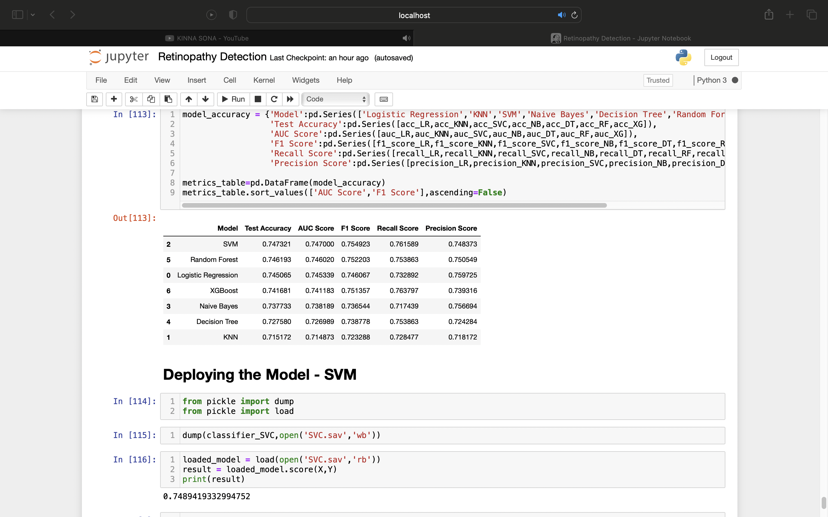
All Model Comparison
We compared all the models on the basis or AUC Score and F1 Score.
We got SVM is performing best with the data.
KNN, is performing bad with the data.
Therefore, we will choose SVM for our deployment.

Slide 10

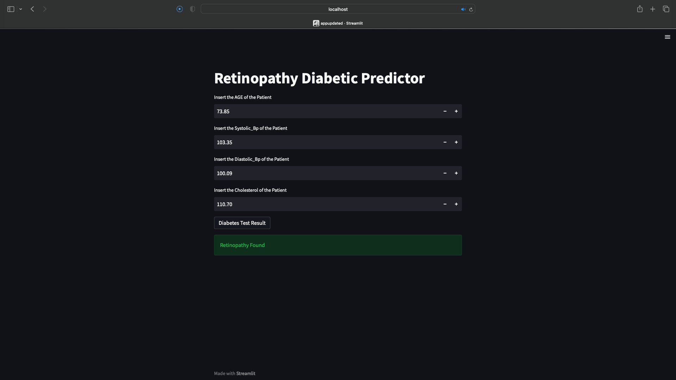
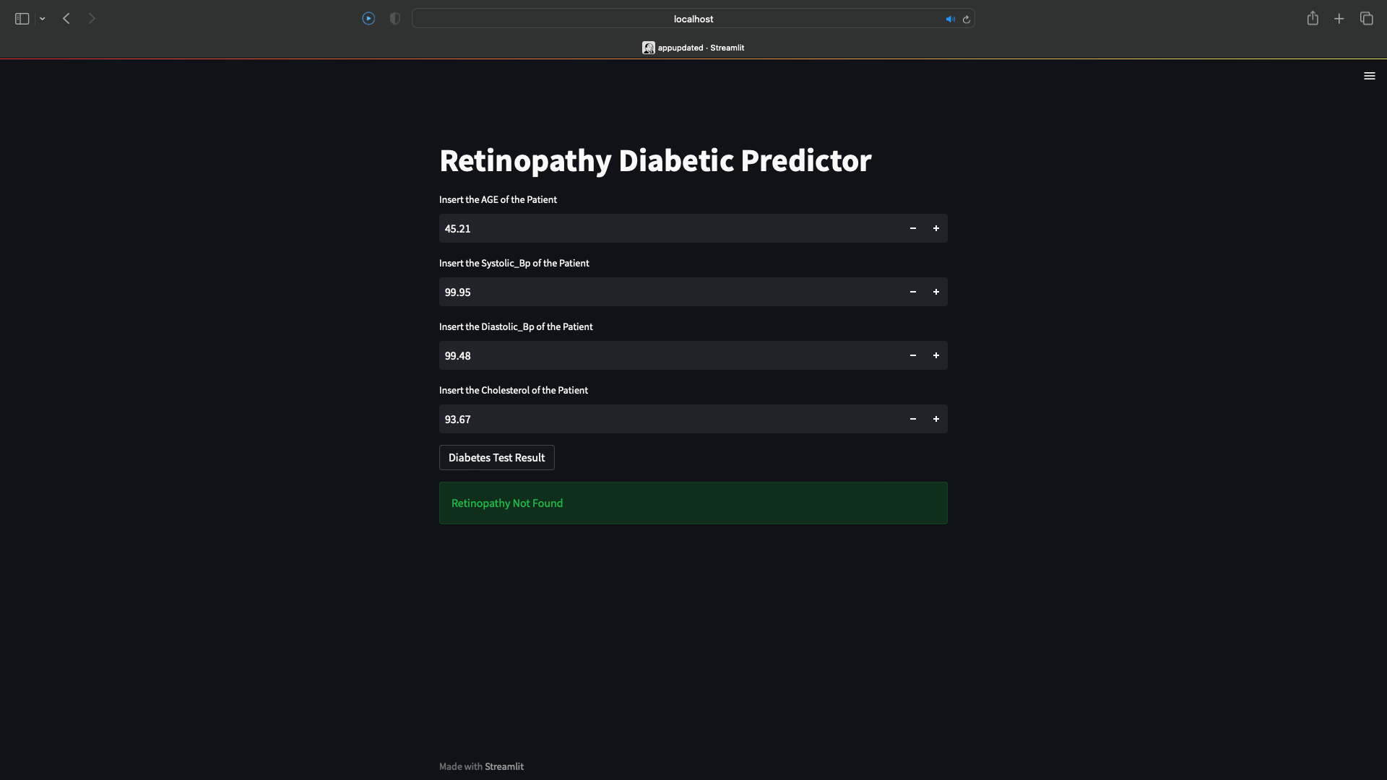
Model Deployment
We have used streamlit to deploy our model.

Slide 11

THANK YOU!

